Slide 1
User Analytics in the Telecommunication Industry - Overview
Project-5
Asha Sandeep
Noida
Digichrome Acedemy
Date-28th August,24

Slide 2
Introduction
The telecommunication industry encompasses companies and services that enable voice and data communication across distances.
It includes a wide range of services such as telephone services, mobile networks, internet services, satellite communication, and broadcasting

Slide 3
Project overview
To provide a report to analyze opportunities for growth and make a recommendation on whether TellCo is worth buying or selling. Analyzing a telecommunication dataset that contains useful information about the customers & their activities on the network. Deliver insights managed to extract through an easy-to-use web-based dashboard and a written report.
The analysis is based on aggregated data from a month of xDR (data sessions Detail Record).

Slide 4
Problem statement
User Overview Analysis: Assessing user demographics, behaviors, and preferences to understand the customer base.
User Engagement Analysis: Evaluating user interaction with services, data consumption, and session metrics to gauge engagement levels.
User Experience Analysis: Analyzing network parameters like TCP retransmission, Round Trip Time (RTT), and throughput, along with device characteristics, to assess user experience.
User Satisfaction Analysis: Correlating engagement and experience metrics to derive overall customer satisfaction levels

Slide 5
solution
Business Need An investor specializes in purchasing undervalued assets and requires a detailed analysis of the data underlying TellCo's business to understand the fundamentals and identify profitability opportunities.

Slide 6
Methodology
Data Collection: Utilizing a dataset containing customer activities, network performance, and device usage.
Data Analysis Techniques: Employing statistical analysis, machine learning models, and visualization tools to extract insights.
Feature Extraction: Identifying key factors influencing customer behavior and network performance.

Slide 7
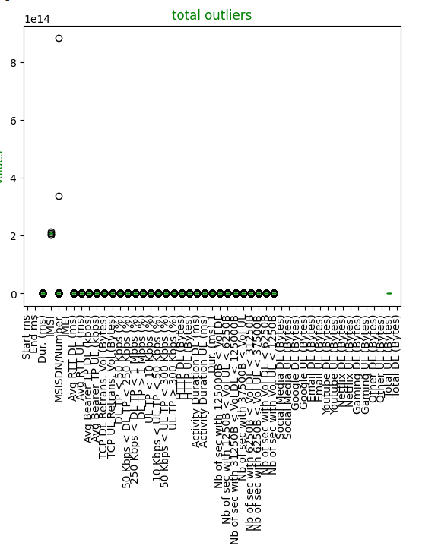
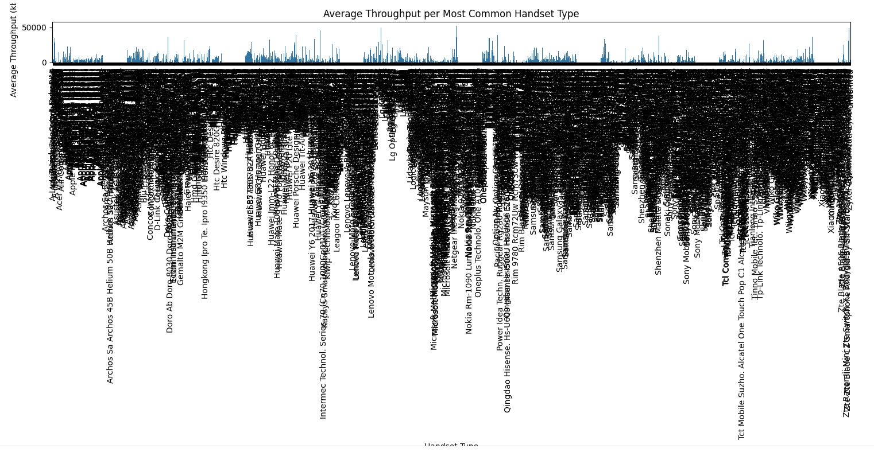
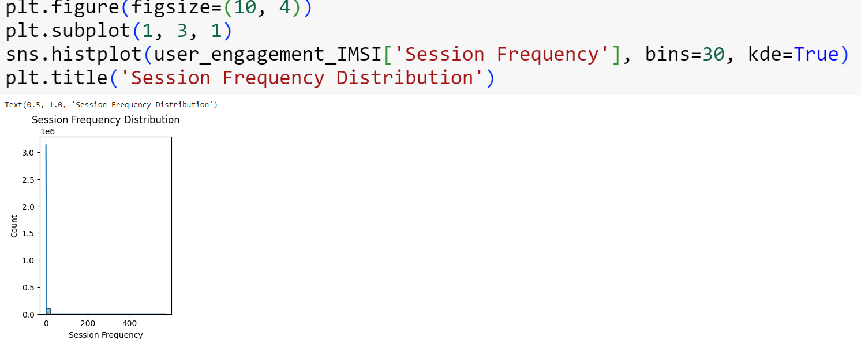
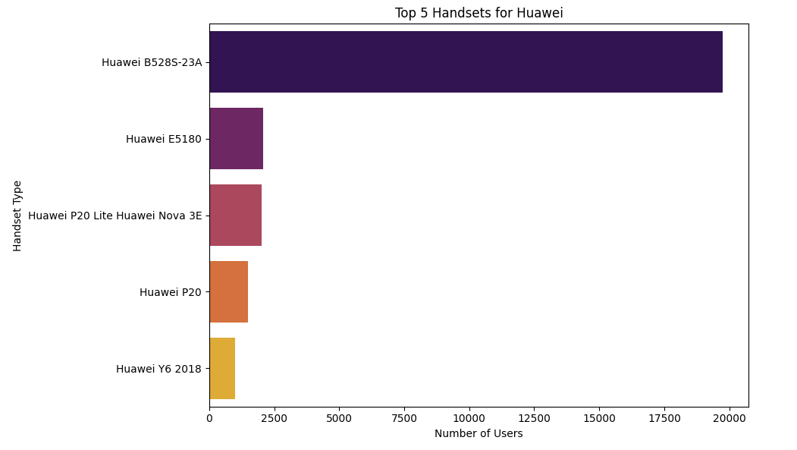
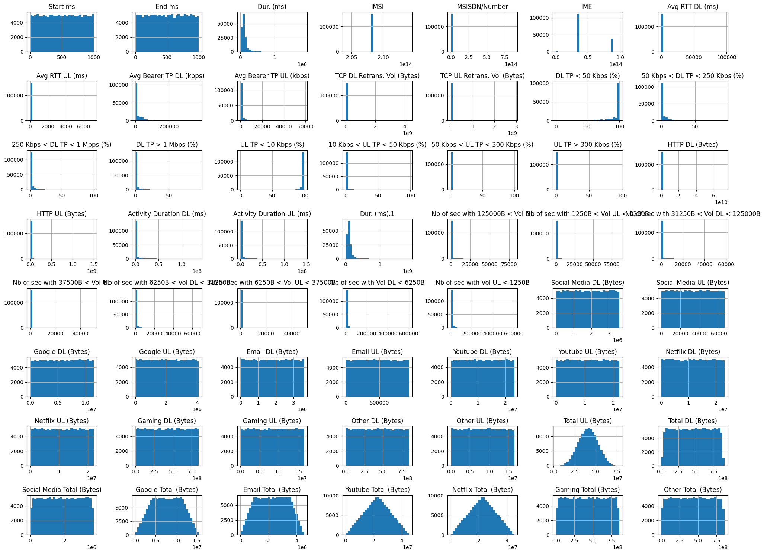
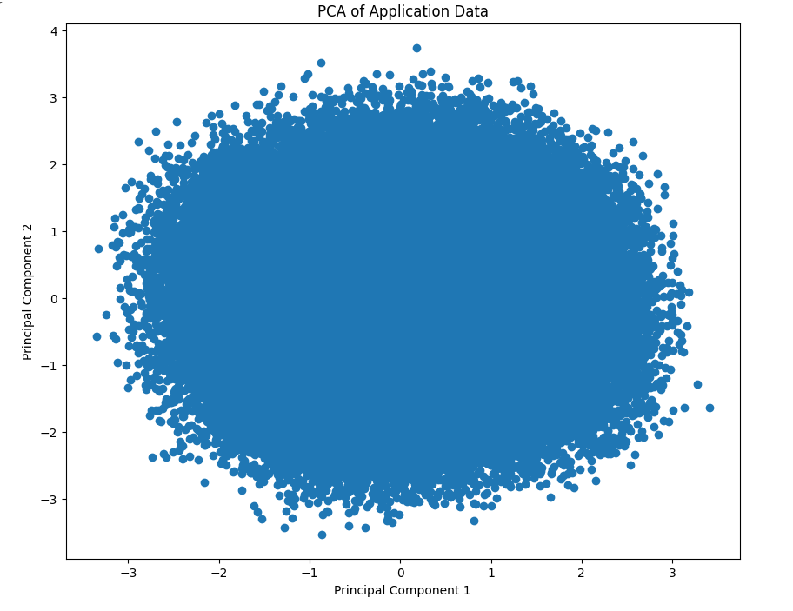
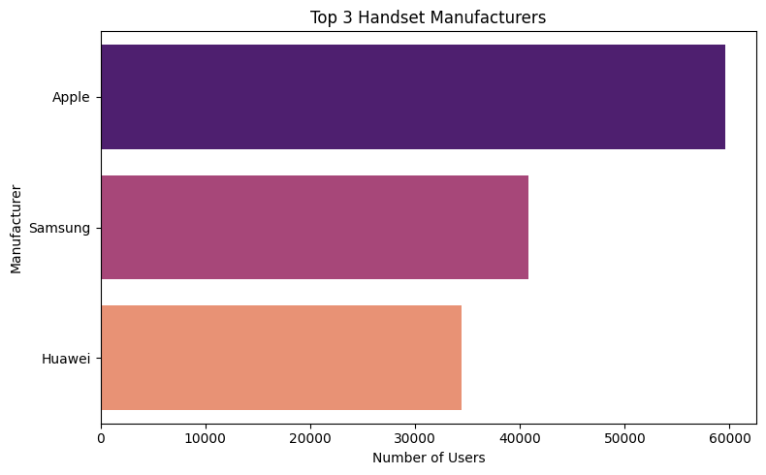
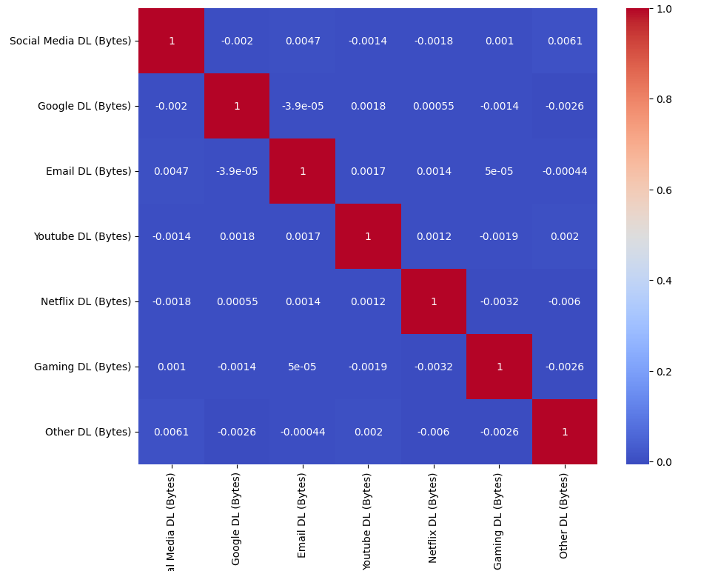
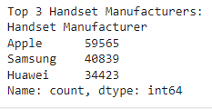
Keyfeatures

Slide 8
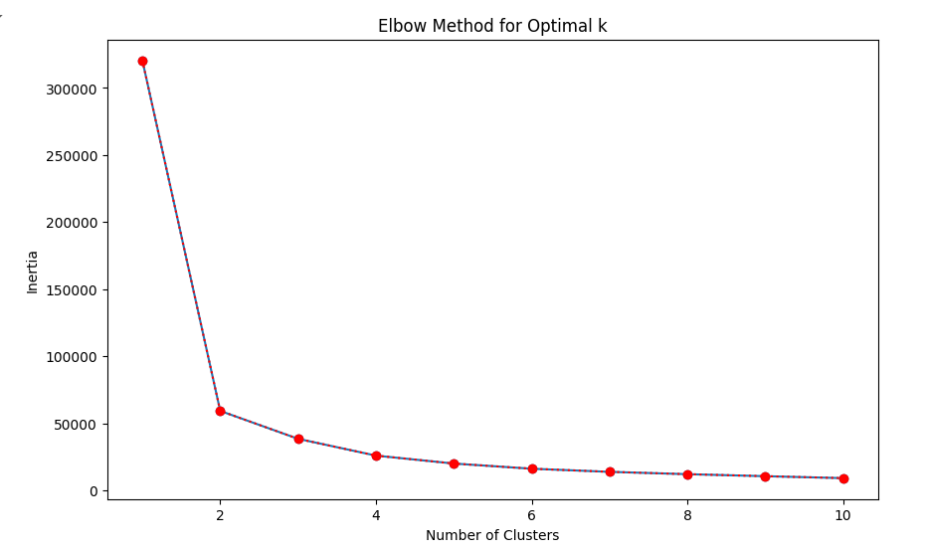
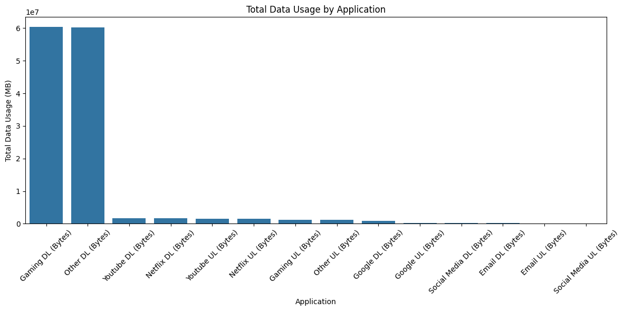
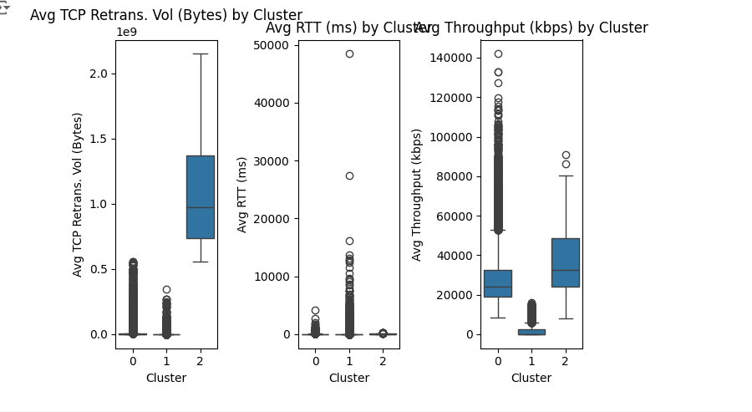
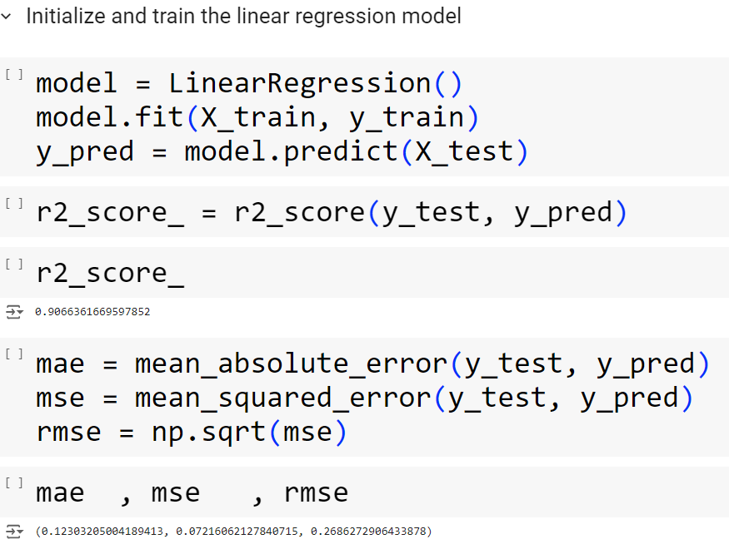
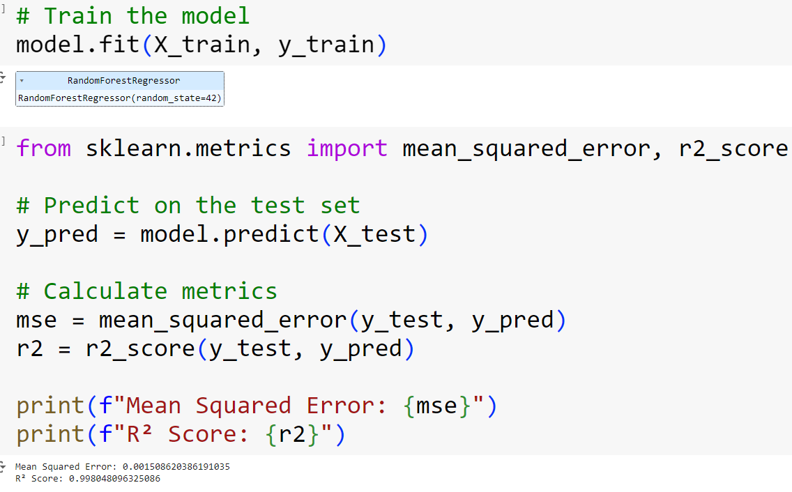
Keyfeatures

Slide 9
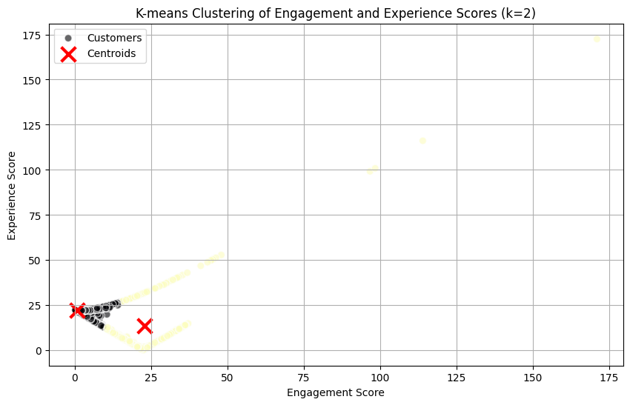
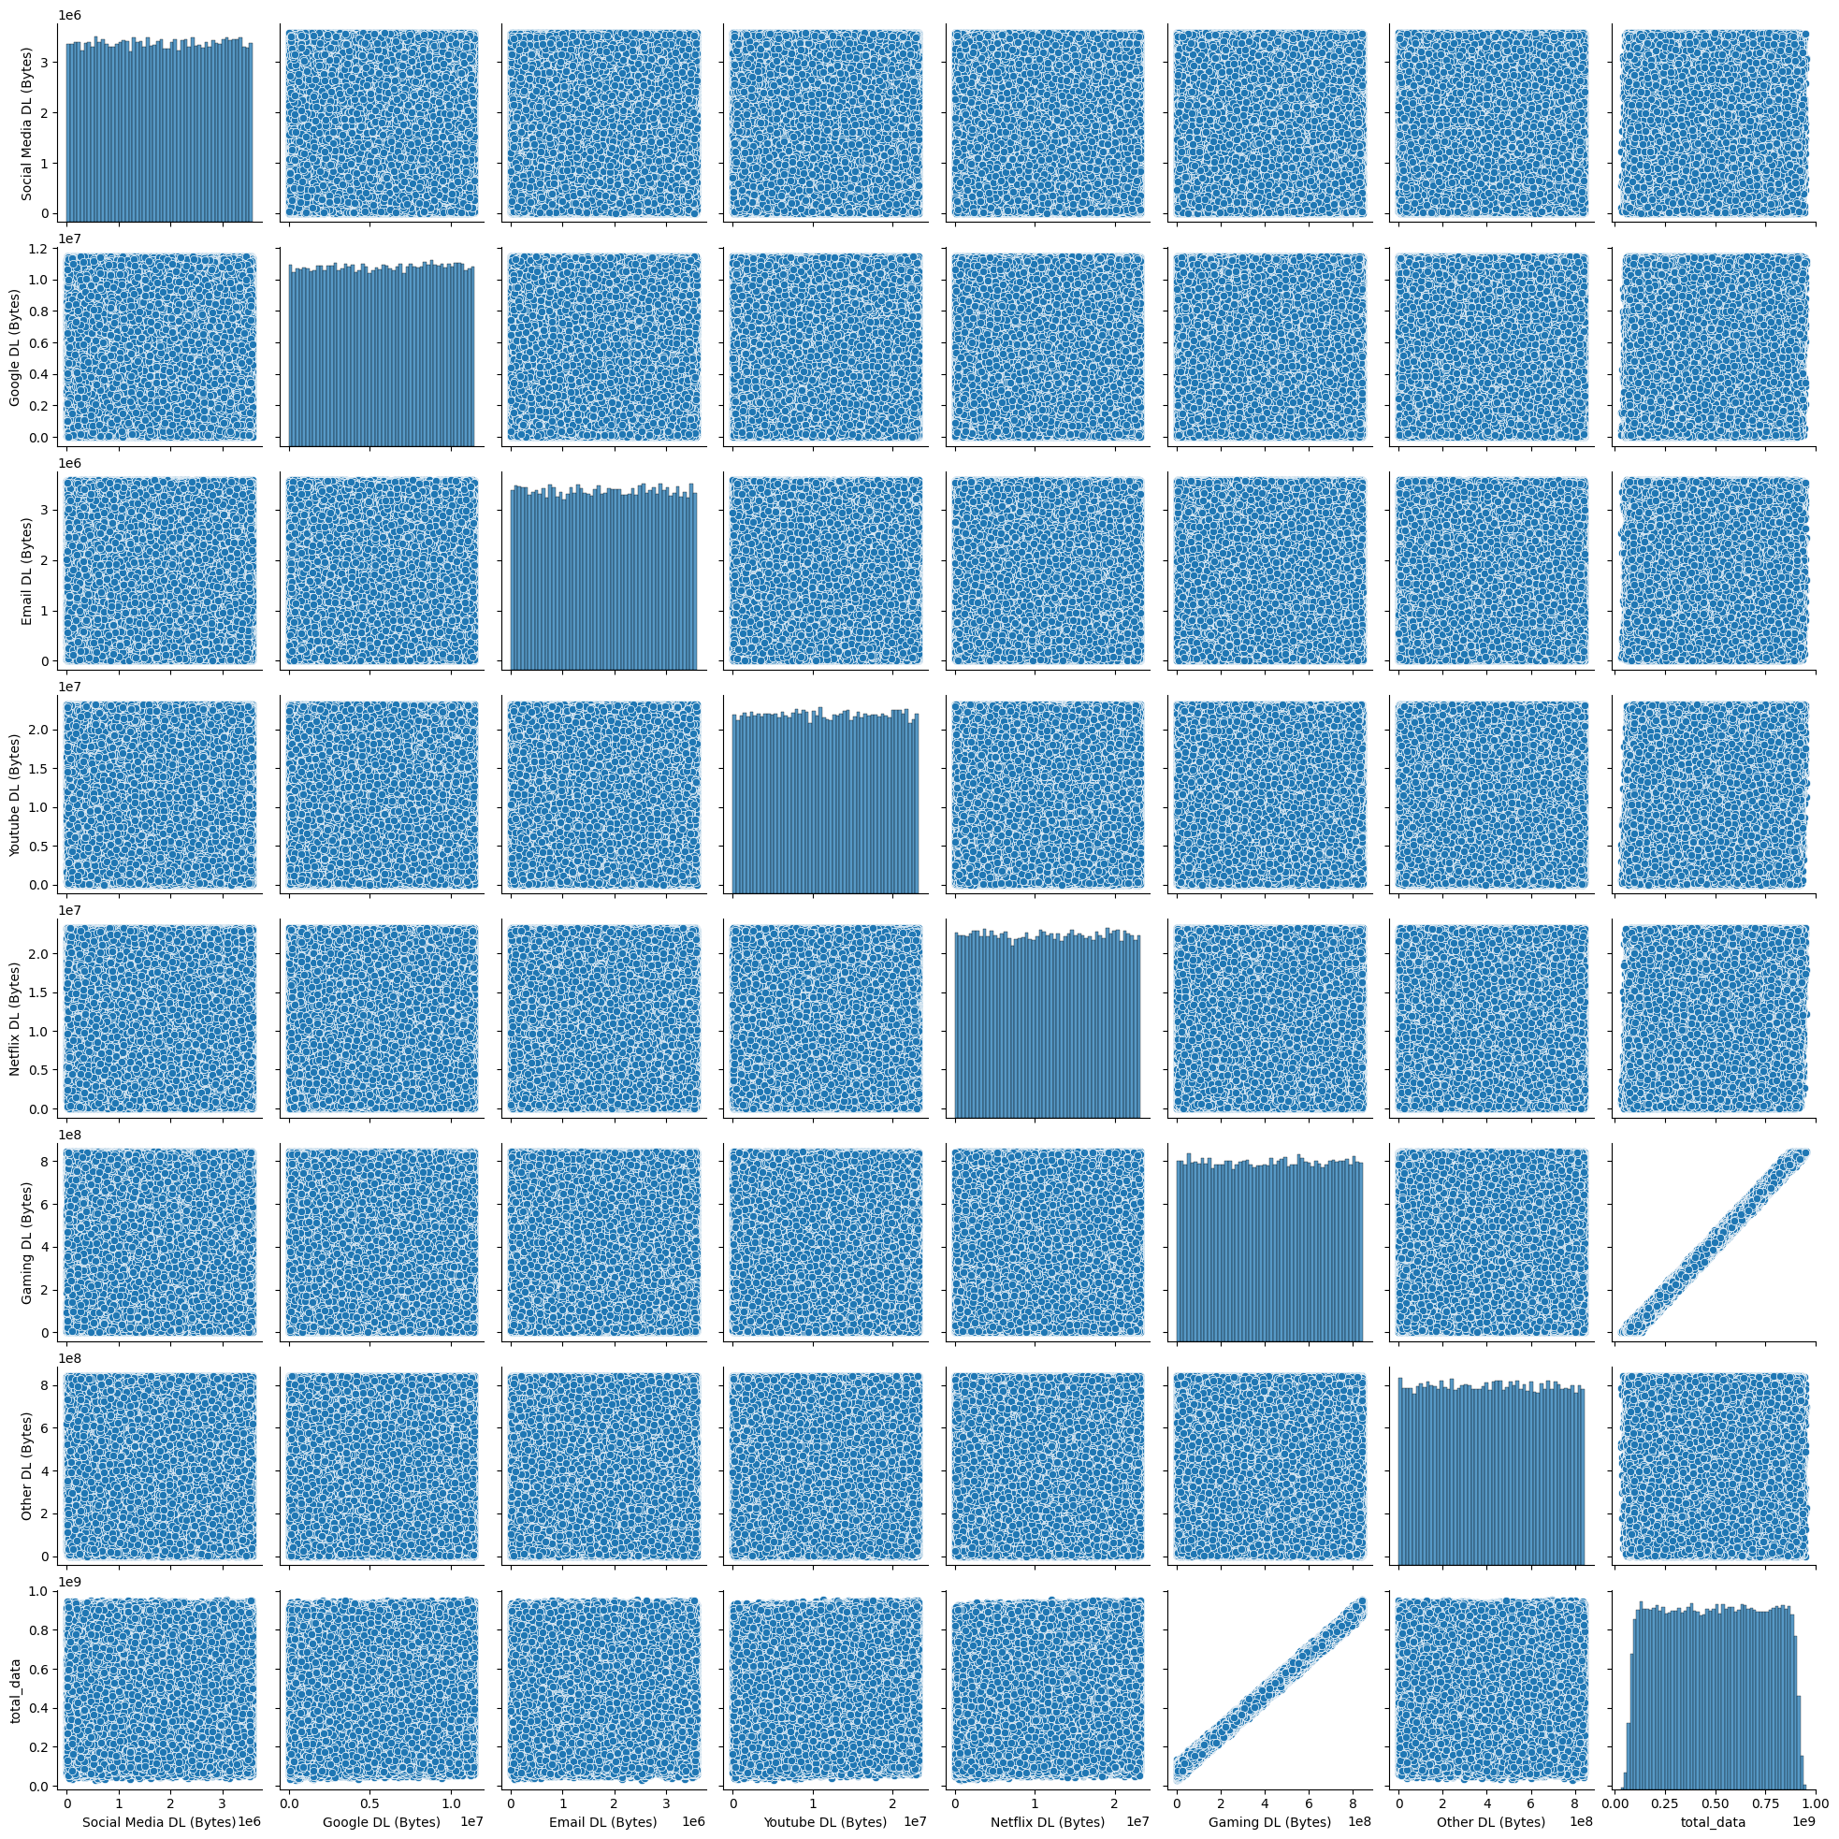
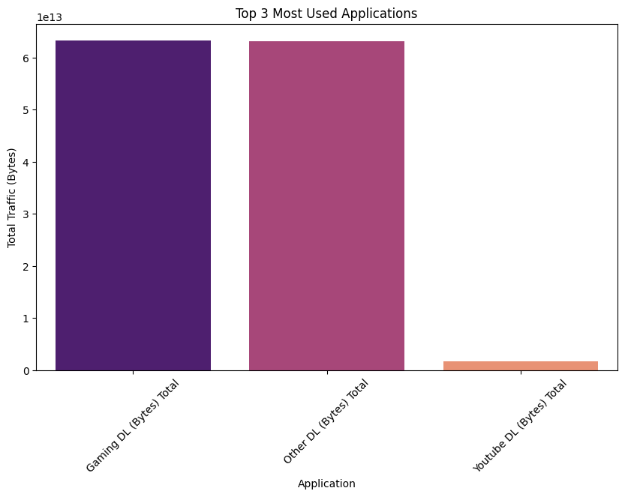
Keyfeatures

Slide 10
Result & Achievements
Some of the columns in the datasets have large percentages of missing values, thus cannot be analysed.
– The data has no timestamp. It might contain old records which might give a false overview of the current situation.
– The analysis is focused only on the user leaving out potential insights that could be obtained from other aspects like handsets-analysis.
– The call detail record (voice channel) is ignored and more focus is put on data sessions detail record.

Slide 11
Challenged faced
i faced challenged in streamlit app and while using a code in vscode it shows always error .

Slide 12
Conclusion
1.User Overview:
The top 10 handsets and top 3 manufacturers dominate the market. Marketing strategies should target these popular devices to maximize reach.
The aggregated user behavior data highlights significant usage patterns across various applications, providing a clear picture of customer preferences.
2.User Engagement:
High engagement metrics were observed for users frequently accessing social media, YouTube, and Netflix. Enhancing network resources for these applications could improve user satisfaction and retention.
K-means clustering revealed distinct user segments based on engagement levels, allowing for targeted marketing and resource allocation.
ntegration and predictive modeling for enhanced decision-making.

Slide 13
Conclusion
3.User Experience:
Average throughput and TCP retransmission rates vary across handset types, indicating potential areas for network optimization.
Clustering users based on experience metrics identified groups with specific needs and challenges, guiding network improvement efforts.
4.User Satisfaction:
Combining engagement and experience scores provided a comprehensive satisfaction score. The regression model accurately predicted user satisfaction, aiding in proactive service improvements.
Clustering satisfaction scores identified distinct user groups, enabling tailored customer service strategies.

Slide 14


